Slide 1
How might we lower
SF rents
Ryan, Jeremie, James, Jaoyi, Wendy

Slide 2
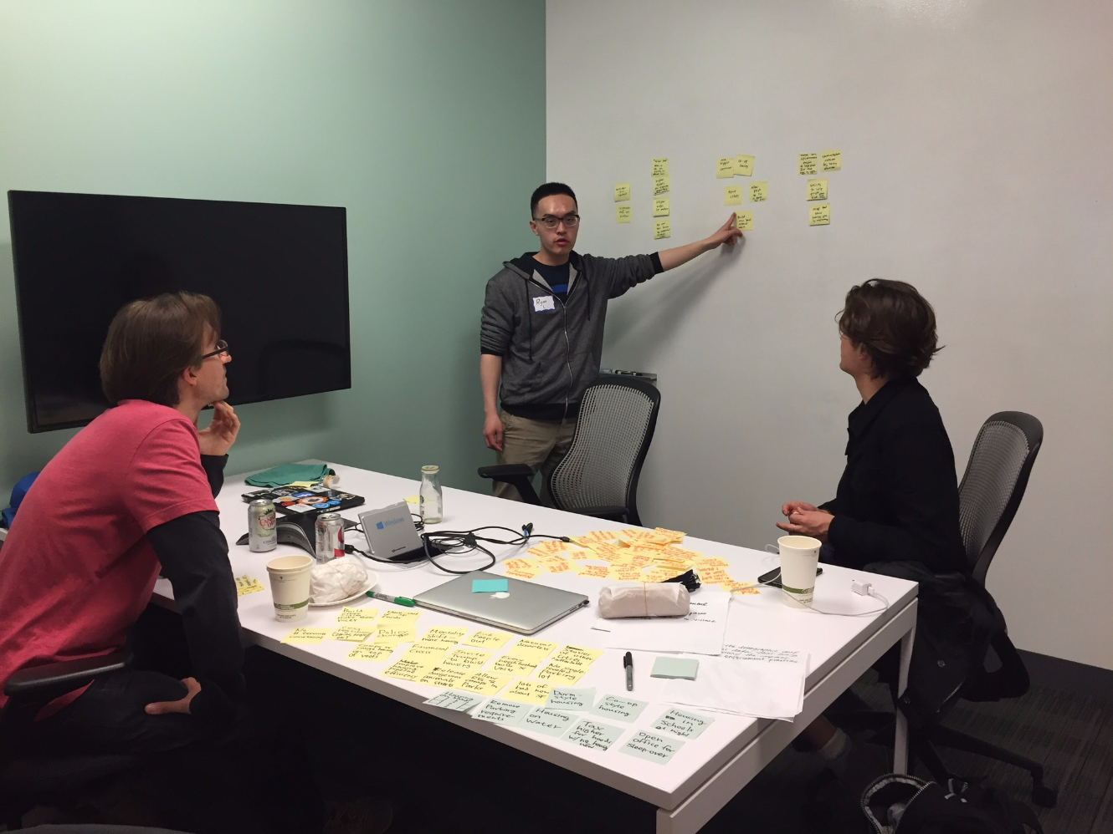
Ideation: how might we lower rent in SF
Idea dump:
15 minutes of idea download

Slide 3
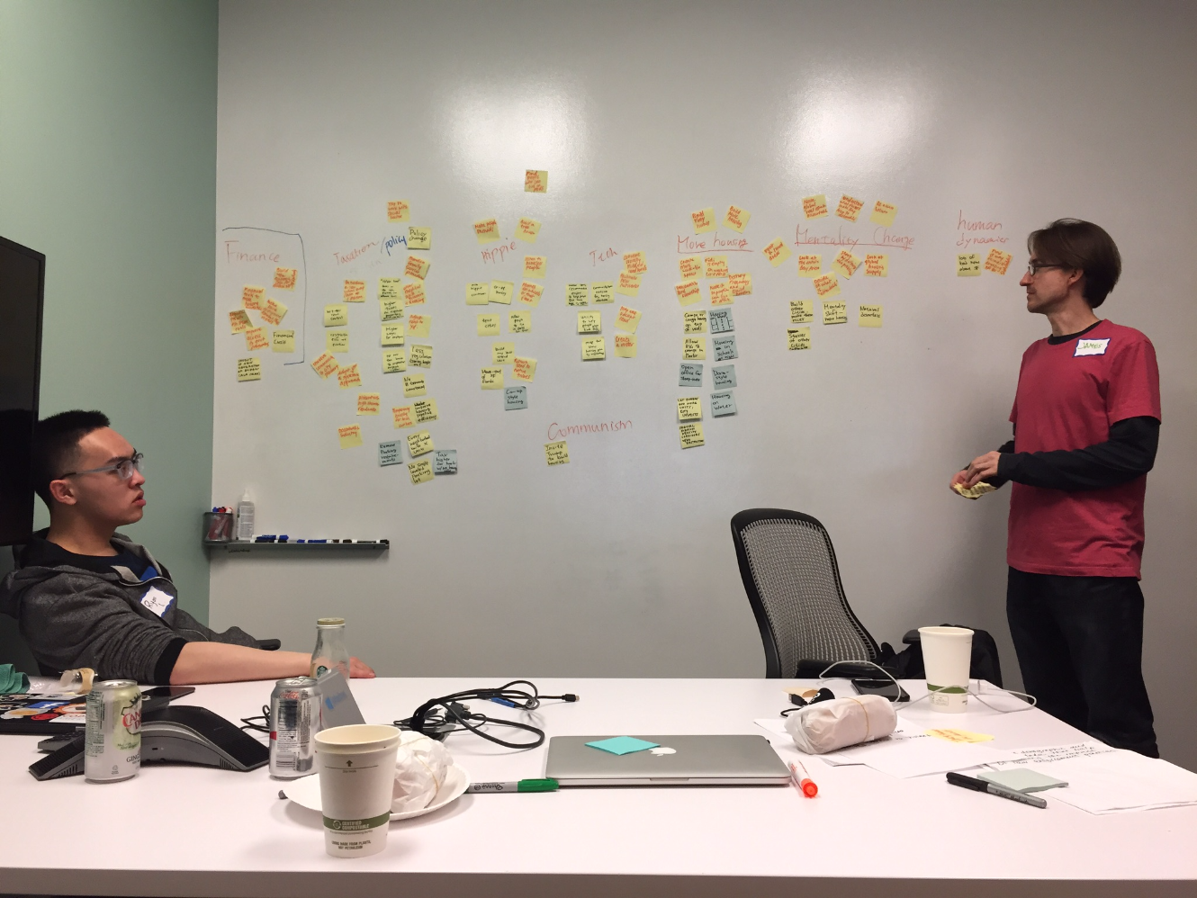
Grouping into major categories
Finance
Policy/ services
Hippie stuff
Tech
Socialism
More housing
Mentality change
Human dynamics
Decision:
more housing

Slide 4
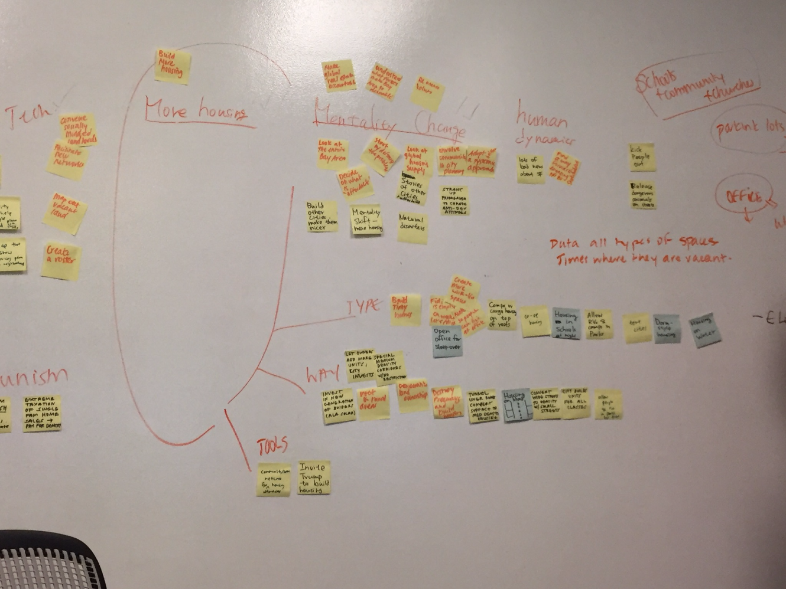
How might we lower rent in SF- more housing
Sort ideas that lead to more housing
Types of housing
Ways of creating housing
Tools

Slide 5
Facts
30% 3-br in SF occupied by families
1/25 kids in SF public schools are homeless

Slide 6
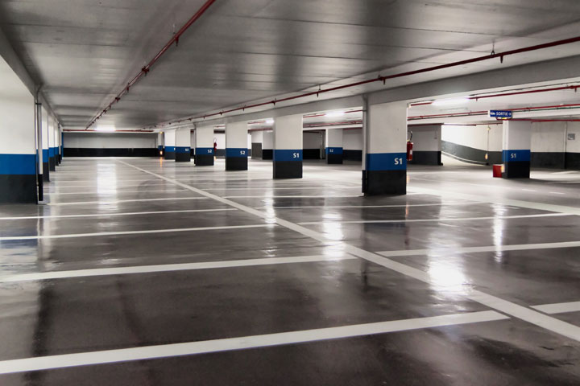
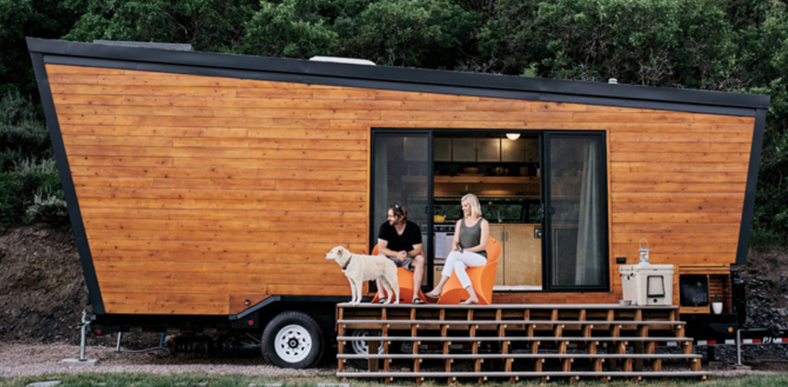
Idea: more housing on public spaces
What if we create mobile tiny homes on public spaces, such as parking garages ?
166,068 off-street parking lots & parking garages in SF
(data source: data.sfgov.org)

Slide 7
Prior Work
Parking Houses: modular housing to fit on city parking spaces
Tim McCormick @tmccormick
http://tjm.org/2012/08/30/parking-houses-modular-housing-to-fit-on-city-parking-spaces/

Slide 8

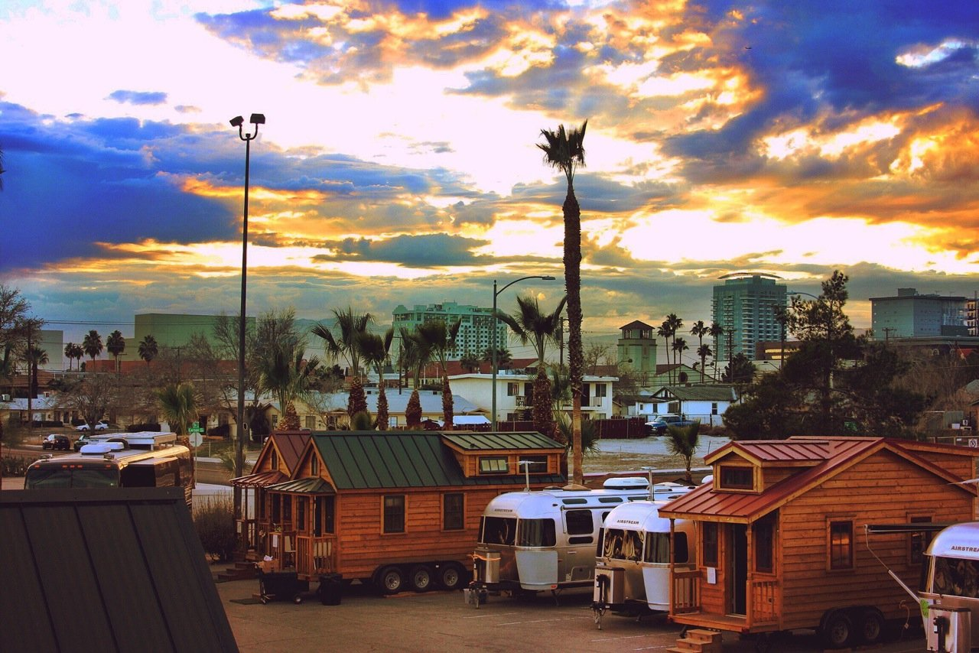

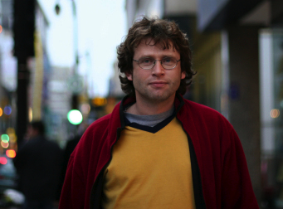
Target initial user: single transient professionals
Single transient professionals
Flexible
Not at home during the day
Minimalistic
Social: mobile-home, co-op style

Slide 9
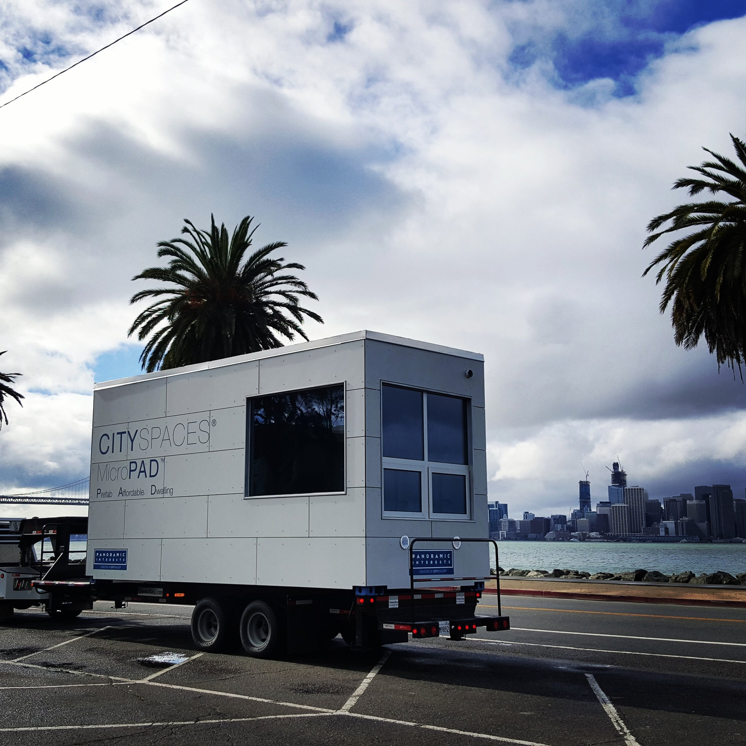
Create an 8pm - 8am Community
Locked storage
Ownership through community
Ownership through equity

Slide 10
How much housing created?
166,068 off-street parking lots & parking garages in SF
1 unit per 2 spaces: converts to 80,000 units

Slide 11
Requirements
Standard vehicle type
Dealing with community issues
RV Ticketing needs to stop
Legalize “Housing on Wheels”
Mechanism to distribute units, store

